Slide 1
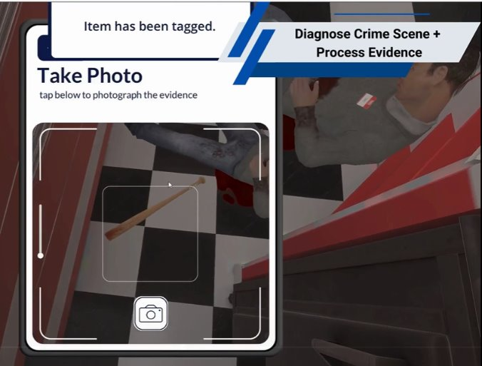
Closing Retro x CSI & Traffic 2.0
November 2024

Slide 2
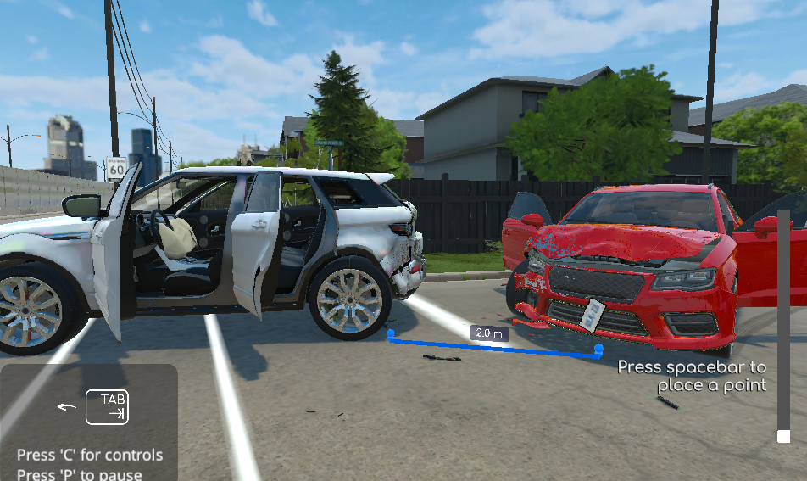
Agenda
Recap
Successes
Challenges
Next Steps
Wrap-Up

Slide 3
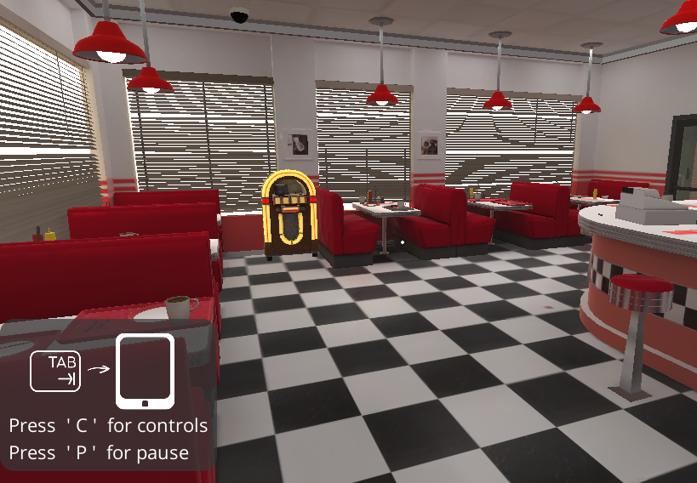
Recap - CSI 2.0
COMMUNITY SERVICES – POLICE FOUNDATIONS
Type of Solution:
Procedural – Professional (Flatscreen)
Students investigate a randomized series of scenarios with criminal actions at a diner and decide which criminal charges are appropriate. They collect and ‘bag’ evidence, write up the report and identify the appropriate charges. New features in this version include additional evidence and more randomized crime scenes, interviewing witnesses and taking statements.
Description of Modules:
Practice Mode – 3 scenario selection options
Hard Mode – 4 scenario selection options

Slide 4
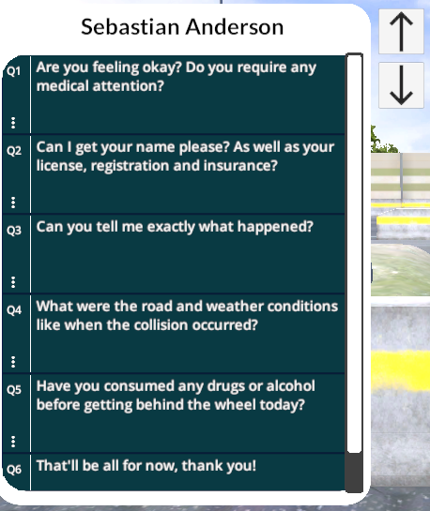
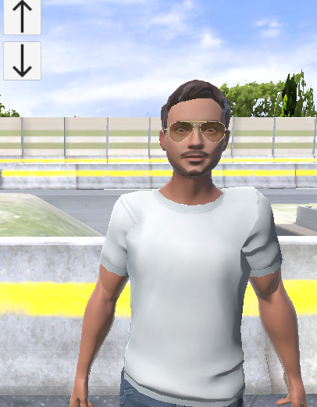
Recap - Traffic 2.0
COMMUNITY SERVICES – POLICE FOUNDATIONS
Type of Solution:
Procedural – Professional (Flatscreen)
Students have the opportunity to apply procedures for investigating a car crash and conducting an analysis on the crash scene to determine what charges (if any) should be laid against the driver(s) involved according to their knowledge and understanding of the Ontario Highway Traffic Act. This version adds environments, weather scenarios, avatar characters to interact with and take statements from, new models of cars, additional possible traffic violations to consider and enhanced measurement capacities.
Description of Modules:
Tutorial Mode
Normal Mode – 3 scenario selection options (Randomized)
Hard Mode – 2 scenario selection options (Randomized)
Highway Mode – 3 scenario selection options (Randomized)

Slide 5

Successes
Improved student experience by incorporating features like:
Replay last instruction button at each step, pause menu (exit, audio on/off), captions and font controls, controls accessible always (button to menu) for both sims
Removing the timer, removing the red herring email and additional duster tool animation for CSI specific
Having the option to have the car doors always open for Traffic
We conducted successful testing sessions with students, which highlighted the significant impact and value of the DLX in enhancing student learning
We successfully identified and resolved issues in avatar features, addressing concerns related to racial and gender biases
In January 2024, we successfully conducted the first in-class student testing session. The results provided incredible data, offering valuable insights for future development and refinement
Notes:
Discuss what went well during the project
Identify key challenges or issues encountered

Slide 6

Challenges
Lack of a formal review process for visuals, text, and user experience before builds are delivered
Greater emphasis on design, rather than aesthetics, could improve the overall student experience
The need to prioritize instructional design considerations
Inconsistent and unreliable timelines for receiving builds
Content edits requiring additional time and research due to a lack of CE.
Communication challenges regarding new builds (ie older builds no longer support email, but this was not communicated to PM and ID)
Inaccurate review documentation causing extra time to ensure accuracy
Issues with bias in witness images and statements
Significant need for external tutorial support to guide navigation beyond the simulation itself
Notes:
Discuss what went well during the project
Identify key challenges or issues encountered

Slide 7

Next Steps
Celebrate!
The Police Foundations students can practice their critical thinking and reporting skills in scenarios that would otherwise be DICE.
What's Next?
Faculty support
Communications

Slide 8

Wrap Up
Think of each of us as holding a piece of a puzzle. Together, as a team, we piece together the full picture—the project. Each of our contributions makes a big difference
Remember: Stakeholder engagement is key. Engage early, engage often!

Slide 9

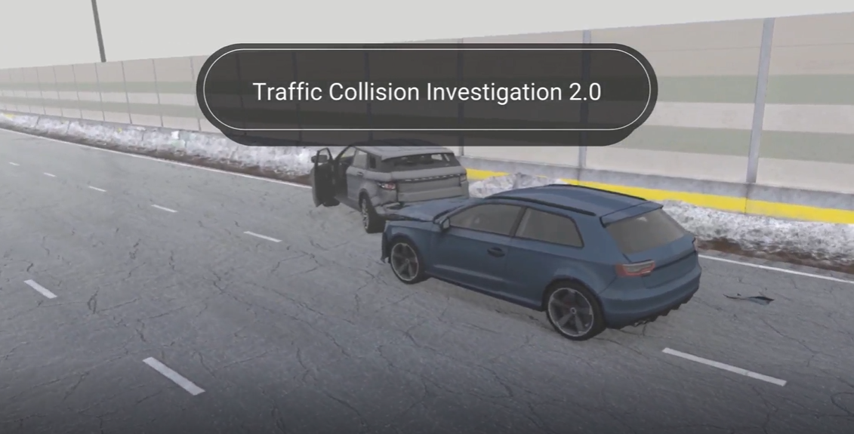
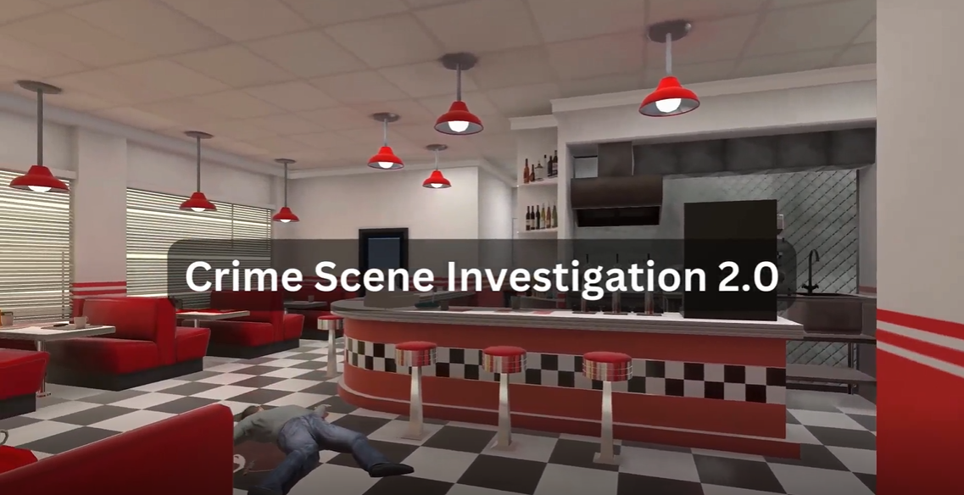
CSI and Traffic Videos

